Slide 1

Campus Convening on Climate Change
RESEARCH IN ENERGY AND MATERIALS
May 25, 2022
STRATEGIC PLAN: MSU 2030

Slide 2
Agenda:
Opening remarks – Doug Gage, VP for Research and Innovation
Introductions – Doug Buhler, AVP Research and Innovation
Research flash talks:
Qingxu “Bill” Jin, assistant professor in the Department of Civil and Environmental Engineering
Annick Anctil, associate professor in the Department of Civil and Environmental Engineering
Dong Zhao, associate professor, Construction Management - School of Planning Design and Construction
Eric Hegg, professor, Department of Biochemistry and Molecular Biology, and Associate Dean for Research College of Natural Science
Justin Kirkpatrick, assistant professor in the Department of Economics
Networking – table conversations
STRATEGIC PLAN: MSU 2030

Slide 3
Flash talks
First up – Bill Jin
STRATEGIC PLAN: MSU 2030

Slide 4






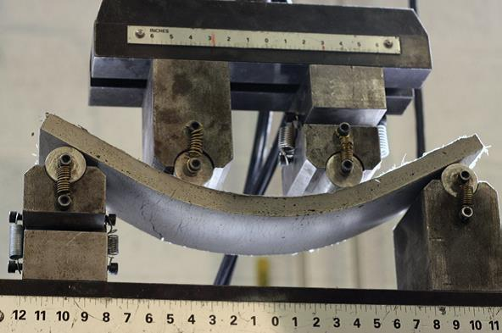
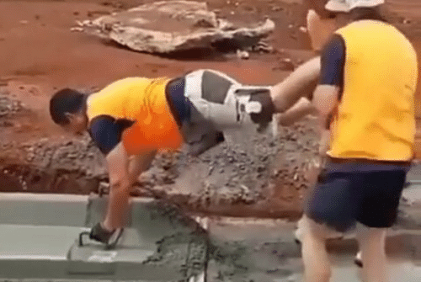
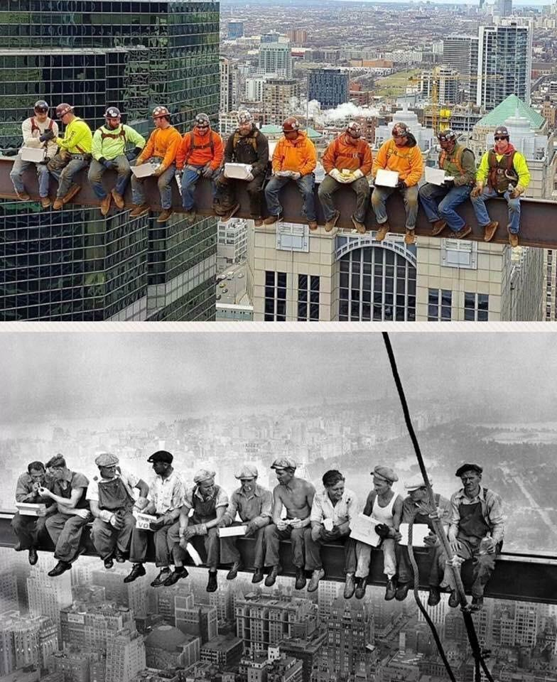



What do we as civil engineers do?
Resilient, Intelligent, Sustainable & Energy-efficient (RISE) Infrastructure Materials Lab
Civil and Environmental Engineering
What our friends think we do.
What our parents think we do.
PI: Qingxu “Bill” Jin
billjin@egr.msu.edu
PhD: Xiaoqiang “Antonio” Ni
What the society thinks we do.
Materials with low carbon footprint
“Smart” Bendable Concrete
Infrastructure Sustainability
Infrastructure Resiliency
Climate Mitigation
Climate Adaptation
What our bosses thinks we do.
What we imagine we do.
What do we actually do?
MS: Quentin Greiner
EnSURE: Luke Naughton

Slide 5
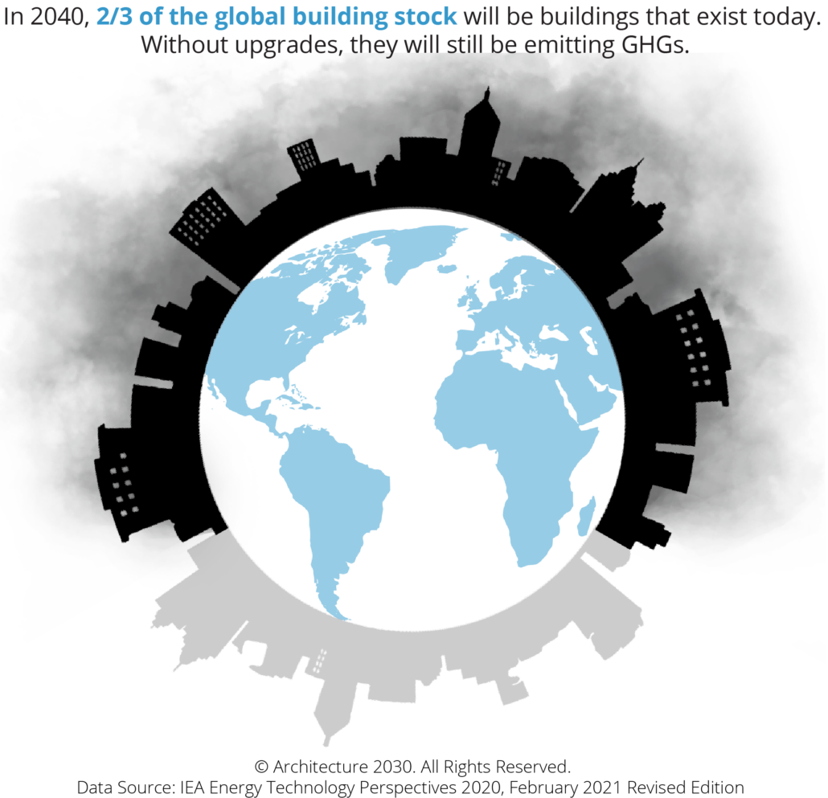
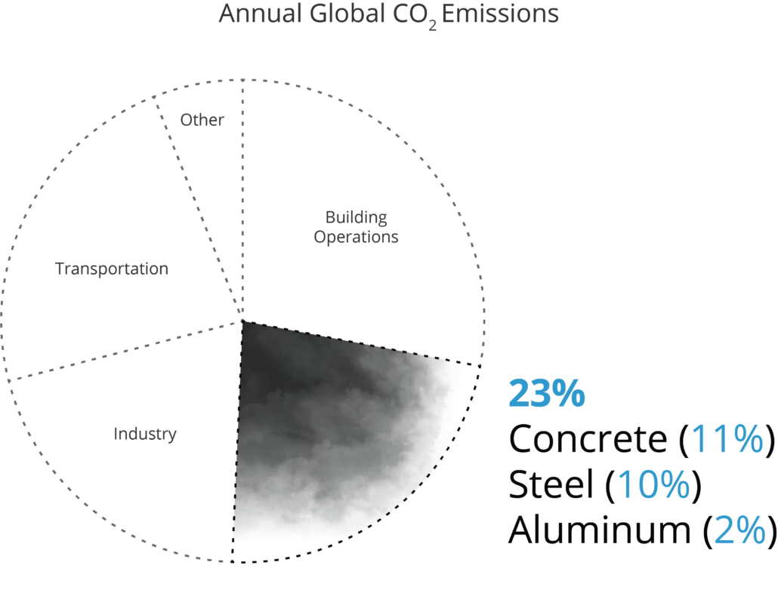
Built environment has high carbon footprint
Construction Materials
We need to mitigate climate change

Slide 6
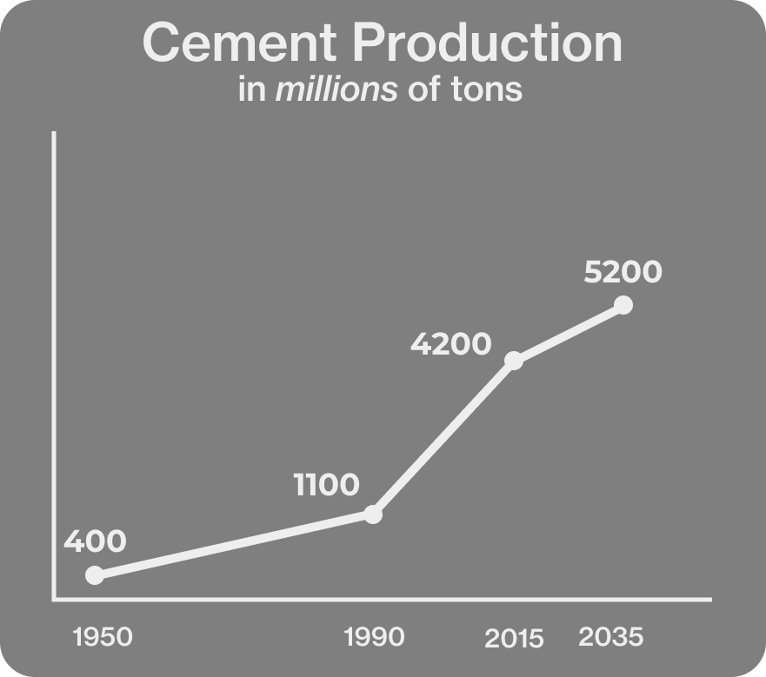

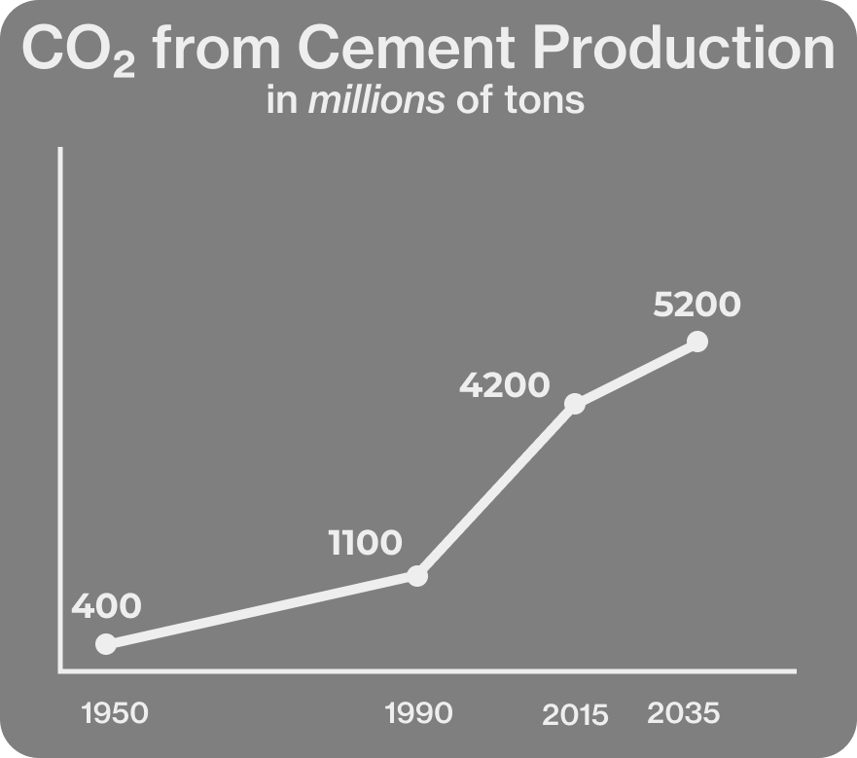
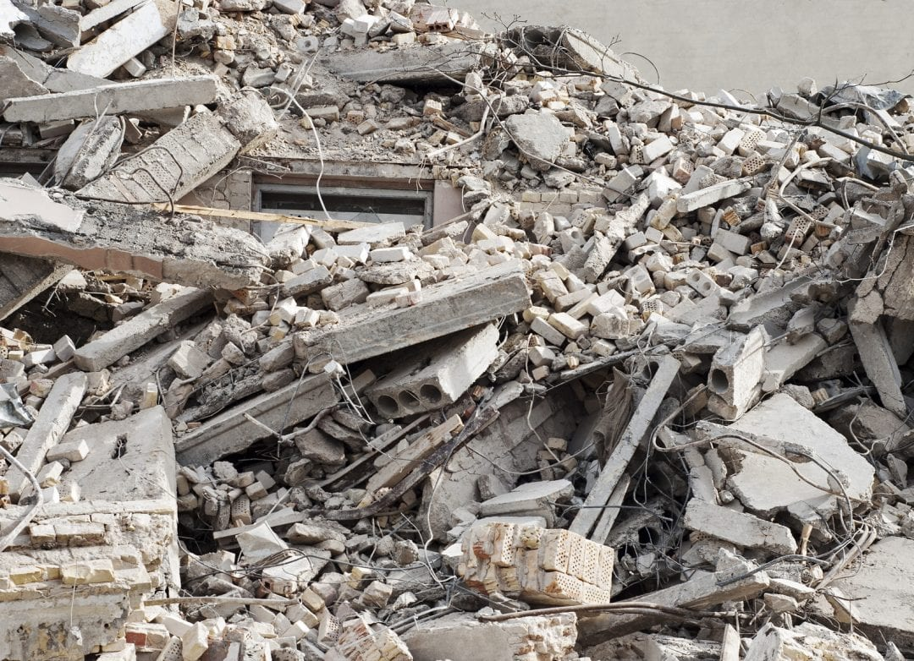
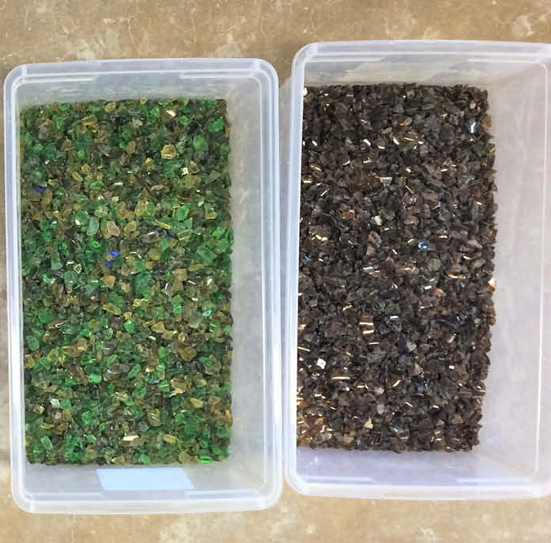
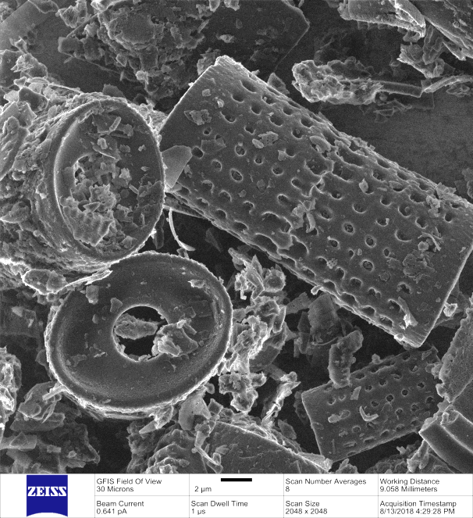

Mitigate climate change through low carbon materials
Alternative cementitious material
Recycled industrial and construction waste
Coal ashes
Biofuel residues
Xu K., Jin, Q., et al.
Paul A., Jin, Q., et al.
Jin, Q. and Ma H.
Li J., Jin, Q., et al. 2022

Slide 7

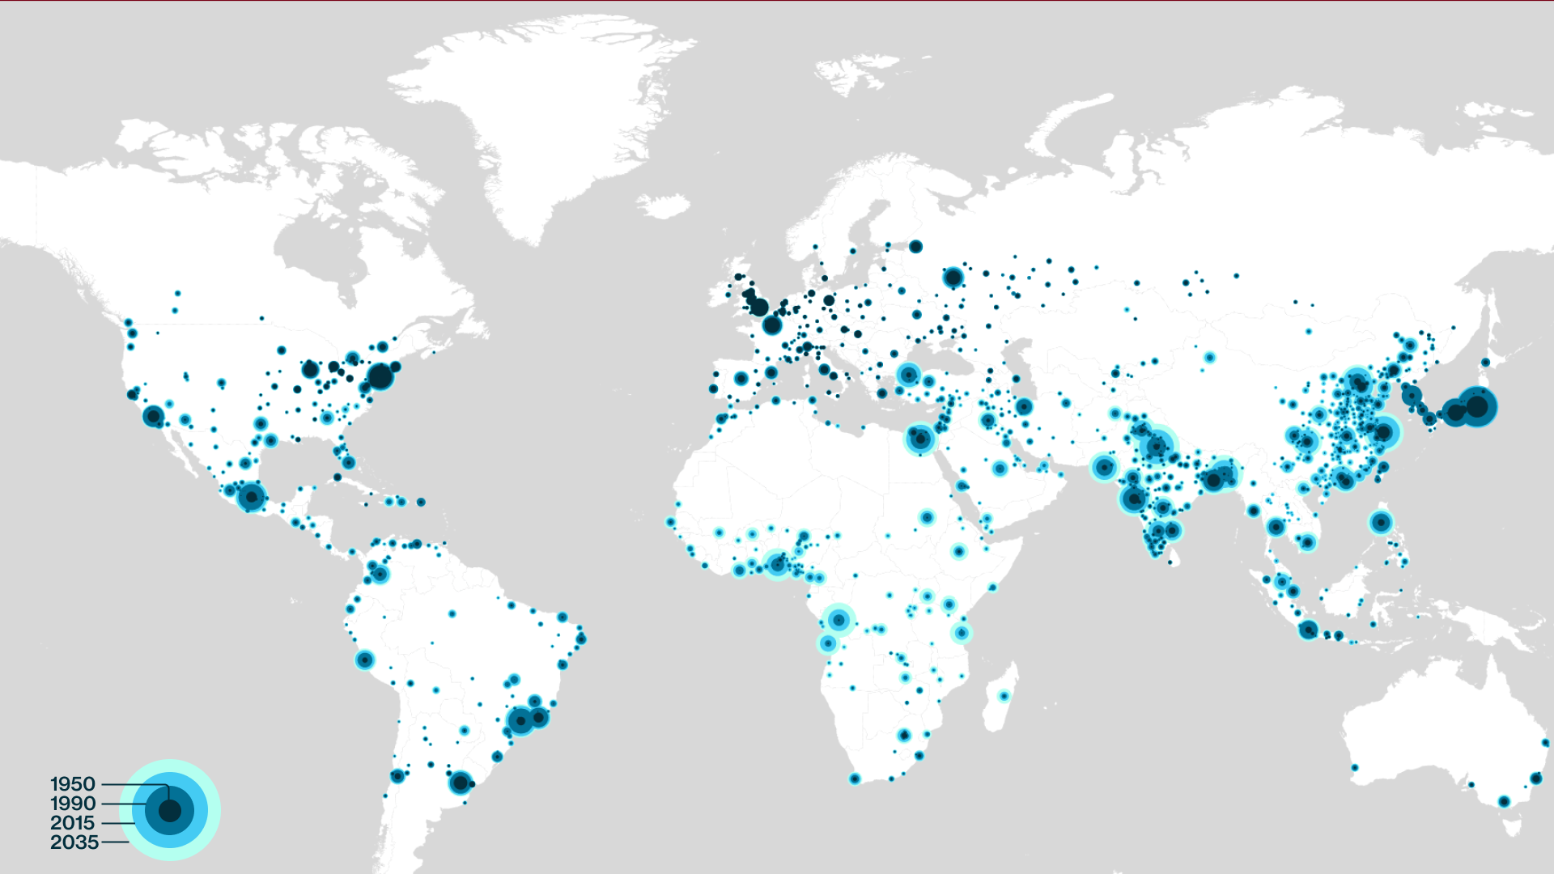



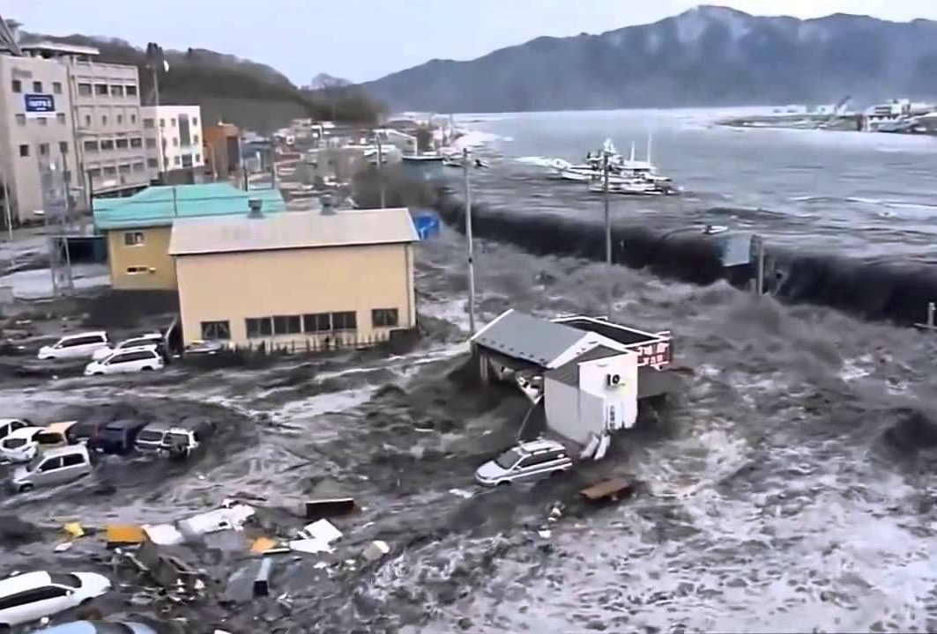

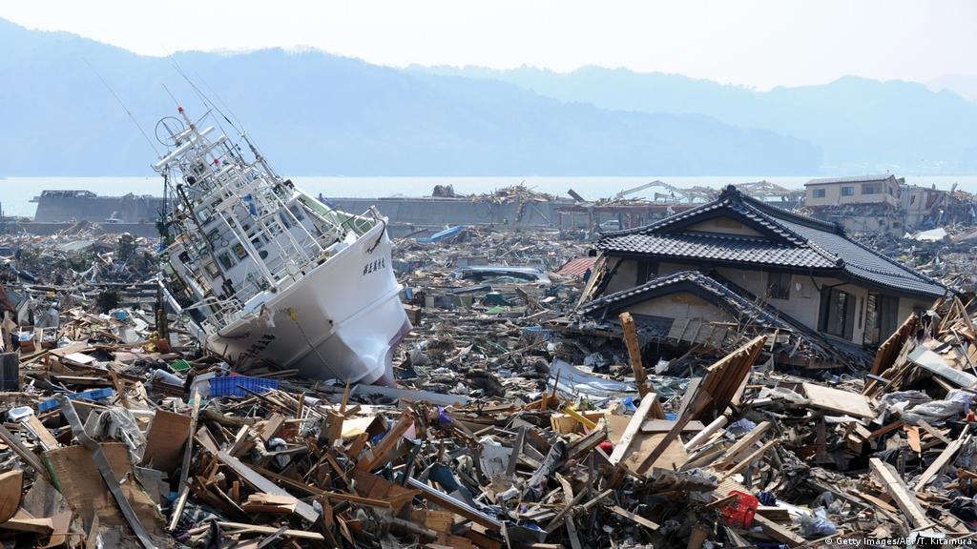
Climate disasters demand resilient built environment
We need to adapt to climate change

Slide 8
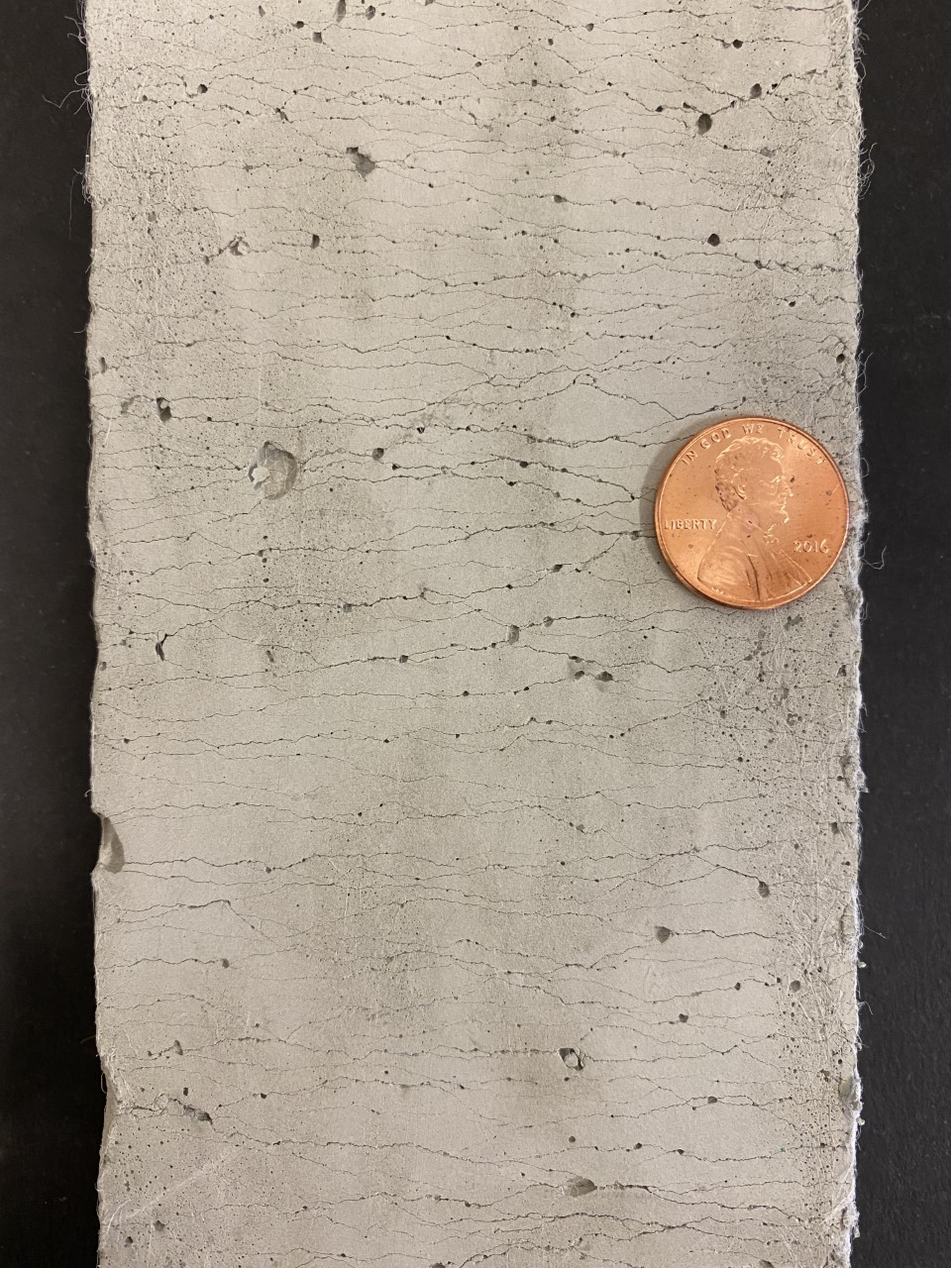

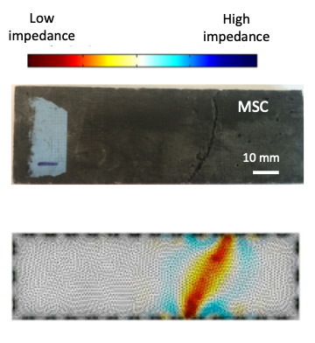

Adapt to climate change through resilient and smart materials
Climate-driven natural disasters
Kesner and Billington 2002
Resilient Infrastructure that adapt to extreme events
(a) Ultra-ductility
(b) Cracking
resistance
(c) Self-healing
d) Self-sensing
Jin, Q. and Li VC. 2019; Jin, Q. and Li VC. 2020; Li and Li 2019; Li 2019

Slide 9
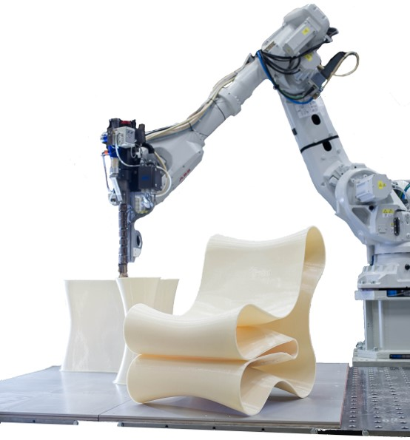

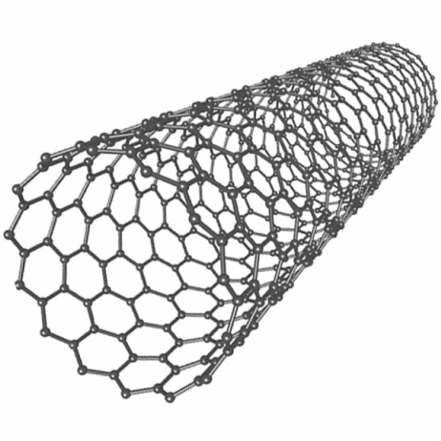


Combat climate change through collaborations
3D printing construction
Resilient Infrastructure
Materials
Science & Design
Climate-driven disasters
Disaster characterization
Climate model
Policy
Machine learning
LCA
Data collection

Slide 10
Next Up Annick Antcil
Next up – Annick Anctil
STRATEGIC PLAN: MSU 2030

Slide 11

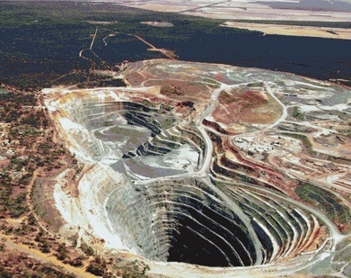
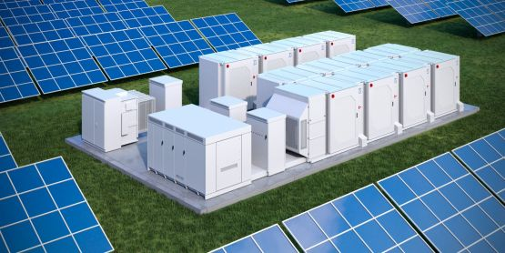
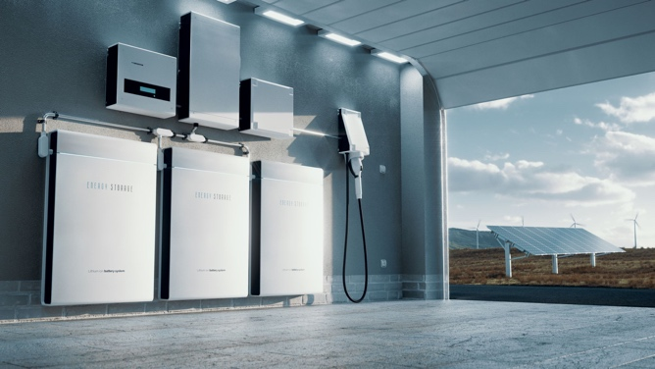
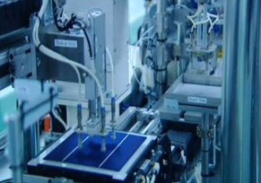
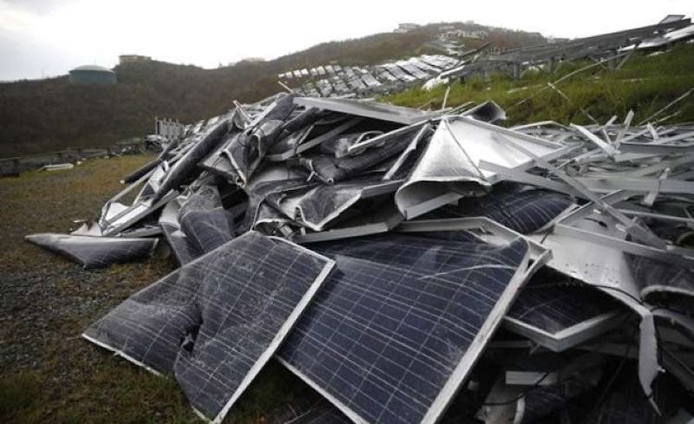







Annick Anctil: Sustainable Energy Systems
Mining
Coal
Natural gas
Nuclear
Manufacturing / Assembly
Renewable
Material Processing
Use Phase
End-of-life
Prospective LCA: evaluate new technology to reduce unintended consequences

Slide 12
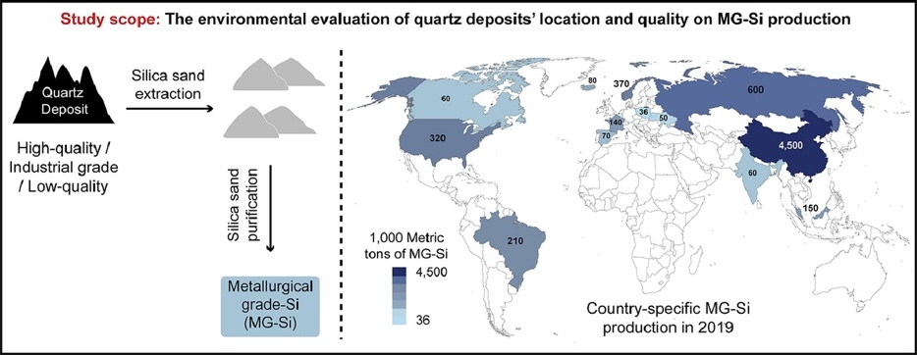
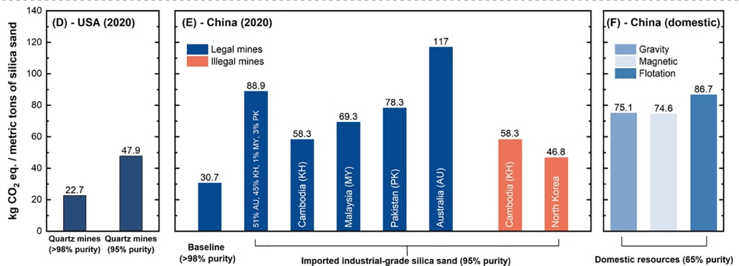
Environmental impact of PV manufacturing
What is the environmental impact of producing silicon solar PV modules in US?
Impact of sand extraction
Impact of module manufacturing
Impact of grid decarbonization on manufacturing
Heidari, S. M., & Anctil, A. (2022). Resources, Conservation and Recycling, 180, 106171.
Notes:
Compare the impact of us vs china manufacturing based on material mining transport and local electricity grid

Slide 13
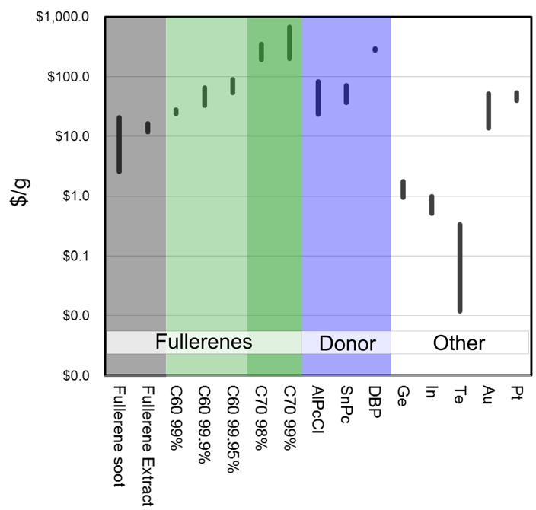
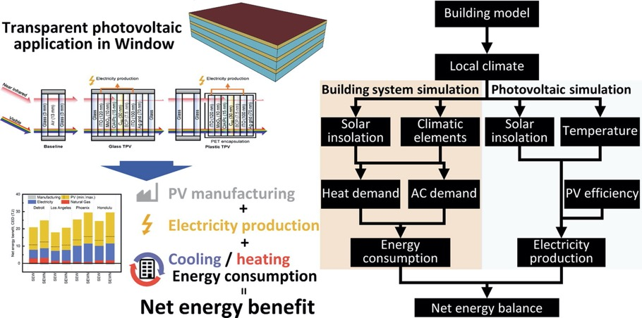

Transparent Organic Photovoltaics
Reducing impact material manufacturing
Net energy and cost-benefit of transparent PV in building-integrated applications
LCA + toxicity + green chemistry
Iterative approach to reduce environmental, cost and chemical hazard
E Lee, CJ Andrews, A Anctil, ACS Sustainable Chemistry & Engineering 6 (7), 8230-8237 (2018)
Anctil, A., Lee, E., & Lunt, R. R. (2020). Applied Energy, 261, 114429.
Notes:
LCA considers both the energy change in the building and the electricity production from the PV to calculate the net energy benefit

Slide 14

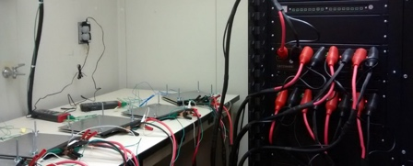
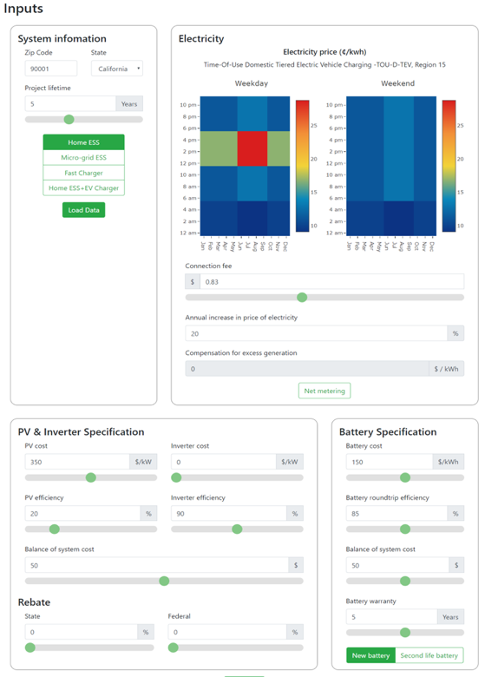
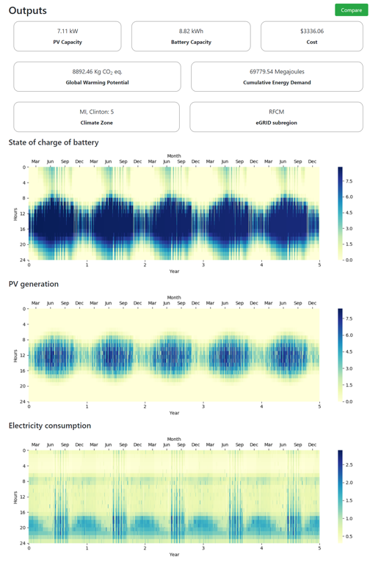
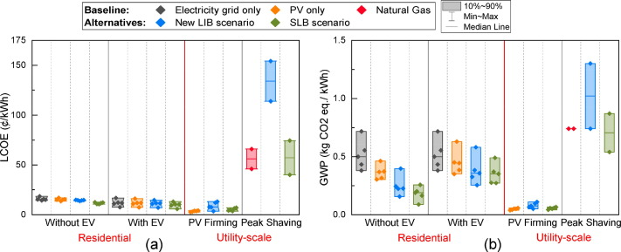
LCA of 2nd life battery from EV
Interactive decision tool for battery storage (1st and 2nd life battery) + solar system design for various applications
Battery testing
Cost and carbon footprint of second-life battery in residential and utility-level applications
In progress: Interactive decision tool for battery recycling
Kamath, D., et al. (2020). Environmental Science & Technology, 54(11), 6878-6887
Kamath, D., et al.. (2020). Waste Management, 113, 497-507.
Notes:
Evaluate the technical, economic and environmental feasibility of using end of life battery for stationary applications in various locations

Slide 15
Projects & Interests
How can we reduce the environmental impact of new (energy) technologies?
Collaborations

Slide 16
Next up Dong Zhao
Next up – Dong Zhao
STRATEGIC PLAN: MSU 2030

Slide 17
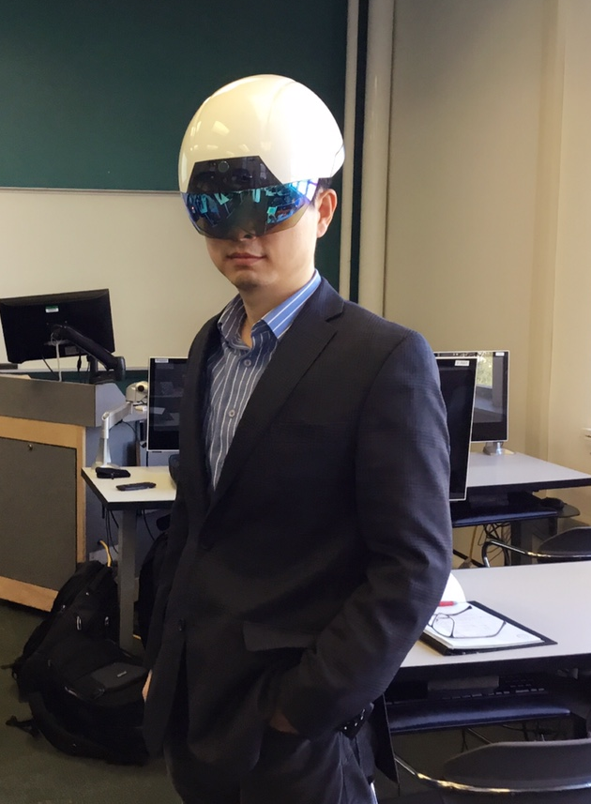
Dong Zhao
Associate Professor of Construction Management and Civil Engineering
School of Planning, Design & Construction
Human-building integration
Green and smart buildings
Building digital modeling
dzhao@msu.edu
www.msu.edu/~dzhao

Slide 18
Routine Occupant Behavior Capture

Slide 19
Large Scale Building Energy Retrofit

Slide 20
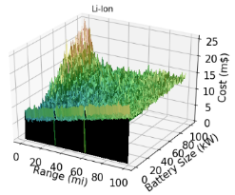
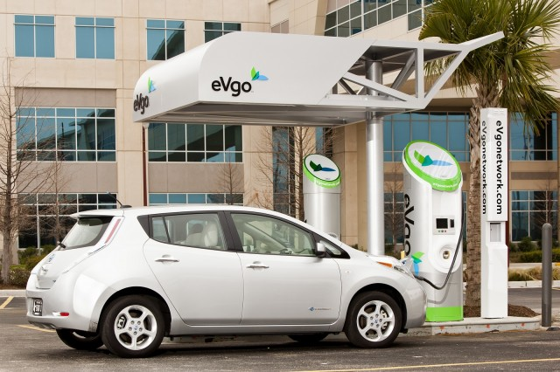
EV and Charging Infrastructure
Notes:
EV-related construction.
EVs have almost zero emissions, which greatly improves environmental sustainability for the U.S. where 29% of greenhouse gas emissions are from vehicles. 18.7 million EVs are estimated to be on U.S. roads by 2030 with a 37% annual growth, based on the McKinsey Center for Future Mobility. China has the largest number of EVs in the world and maintains a 35% annual increase in EV sales [5]. Moreover, major auto manufacturers including General Motors, Ford, and Chrysler are committed to an all-EV future in the next 20 years.
The construction cost of distribution lines are too high. No new grid construction is suggested.
When choosing a small battery size, every charging station needs a batter storage unit.
A combination of a small number of but big size of battery units is preferred to reduce costs
EV-integrated buildings (homes, commercials) - Architecture
Regional sustainable and equitable development - We can work with urban planning and public policy.
Atlanta EV Toyota, Mercedes

Slide 21
Future Research
Design and Construction of EV integrated buildings and infrastructure
IoT-based commercial building retrofit
Digital Twin and human factors in the sustainable built environment
Notes:
EV-related construction.
EVs have almost zero emissions, which greatly improves environmental sustainability for the U.S. where 29% of greenhouse gas emissions are from vehicles. 18.7 million EVs are estimated to be on U.S. roads by 2030 with a 37% annual growth, based on the McKinsey Center for Future Mobility. China has the largest number of EVs in the world and maintains a 35% annual increase in EV sales [5]. Moreover, major auto manufacturers including General Motors, Ford, and Chrysler are committed to an all-EV future in the next 20 years.
The construction cost of distribution lines are too high. No new grid construction is suggested.
When choosing a small battery size, every charging station needs a batter storage unit.
A combination of a small number of but big size of battery units is preferred to reduce costs
EV-integrated buildings (homes, commercials) - Architecture
Regional sustainable and equitable development - We can work with urban planning and public policy.
Atlanta EV Toyota, Mercedes

Slide 22
Next up Eric Hegg
Next up – Eric Hegg
STRATEGIC PLAN: MSU 2030

Slide 23


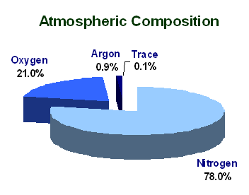
Ammonia as a fuel
Ammonia as a Fuel
Capture
Sunlight is most abundant energy resource, but diffuse and intermittent
Convert
Solar electricity can be concentrated and stored in chemical bonds by splitting water (the most abundant molecule on Earths surface)
2 H⁺_{(aq)} + 2 e– → H_{2(g)}
H₂O_{(l)} → ½ O_{2(g)} + 2 H⁺_{(aq)} + 2 e–
Store / Distribute
Hydrogen is hard to store and distribute. It can be combined with nitrogen (the most abundant molecule in the atmosphere) to make ammonia which is already stored and disturbed globally at large scale
Use (our vision)
We are investigating conversion of ammonia back to H₂ or electricity to complete the renewable energy cycle.
Haber Bosch is >80% efficient
N₂ + 3 H₂ → 2 NH₃

Slide 24
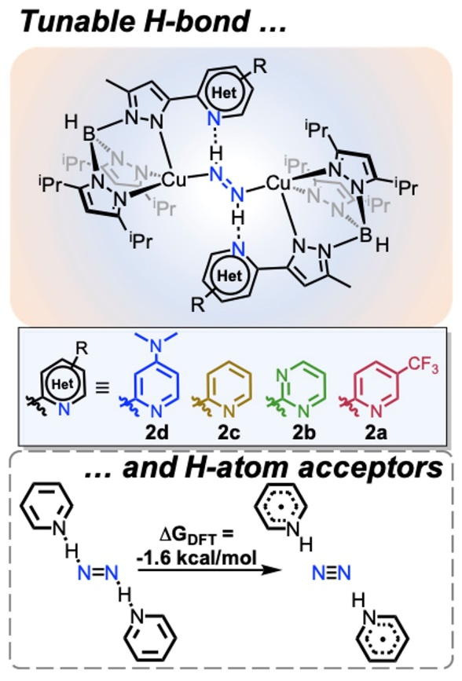
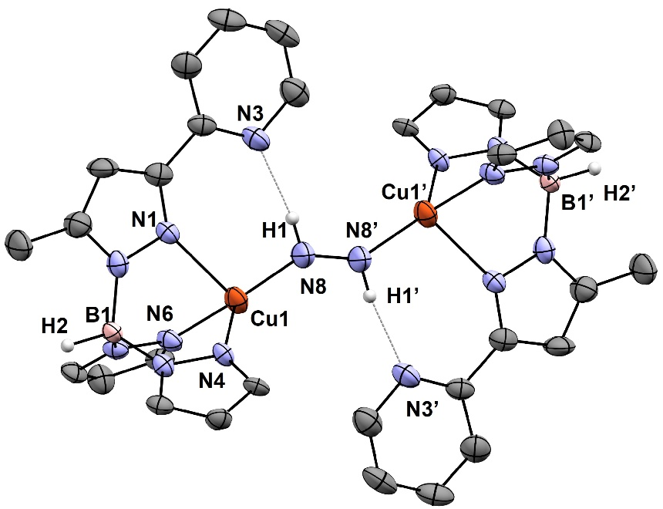

Ammonia Storage and Electrolysis
Ammonia Storage and Electrolysis
Focusing on the most energy intensive step in N₂ → NH₃ conversion:
addition of the first two H-atoms
Pairwise addition of H-atoms to N₂ via H-bonding lowers thermodynamic barriers for N₂ reduction.
Warren and co-workers
J. Am. Chem. Soc. 2021, 143, 15960.
New molecular catalysts based on earth abundant metals release energy from NH₃ via electrocatalysts:
Simple and robust catalysts that function in liquid ammonia
Warren and co-workers: ChemRxiv 2019; under review
Warren Lab (Chemistry)

Slide 25
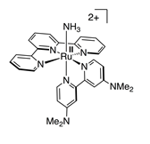
Ammonia Storage and Electrolysis continued
Ammonia Storage and Electrolysis
Hamann and Smith (Chemistry) discovered way to store liquid ammonia at room temperature and ambient pressure which can be electrolyzed to produce hydrogen on demand
Hamann and Smith Groups (Chemistry) reported first molecular electrocatalyst for ammonia oxidation
Joule 2022, 6, 1 – 10
Proceedings of the National Academy of Science 2019, 116 (8) 2849–2853

Slide 26
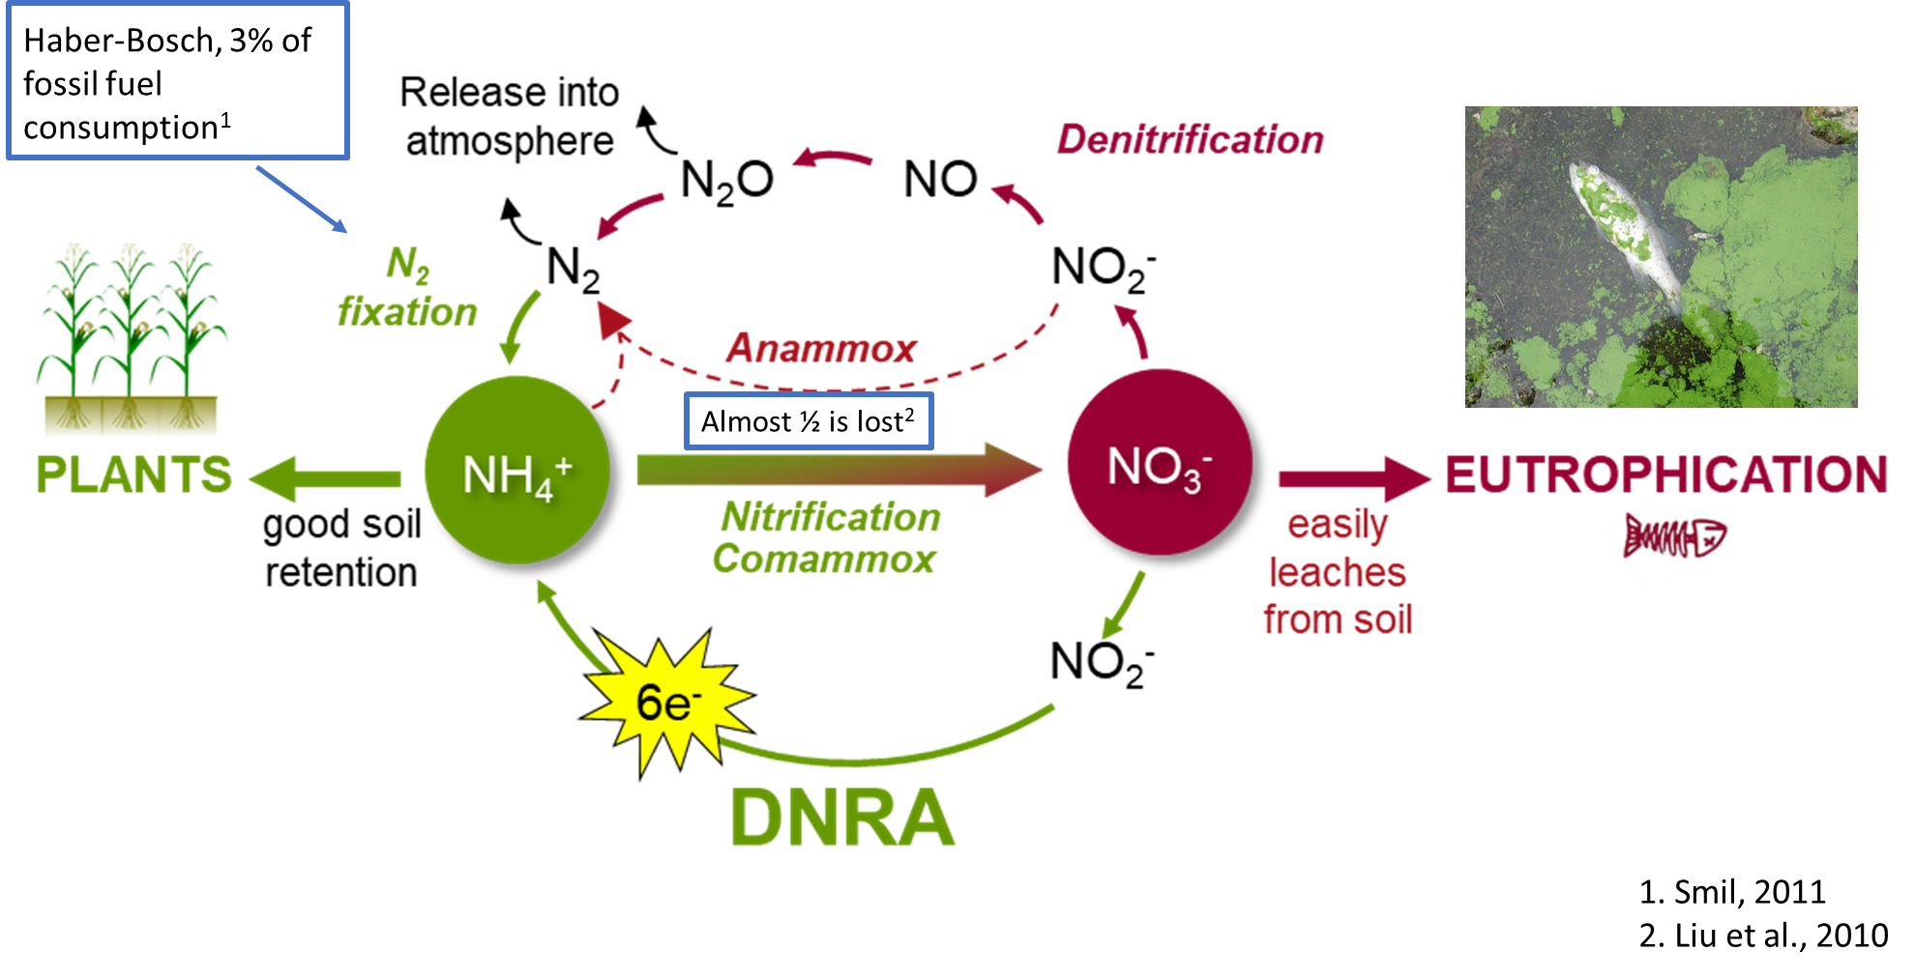
Biological Nitrogen Dioxide Reduction to Ammonium
Biological NO₂⁻ Reduction to NH₄⁺
NO₂⁻ + 8H⁺ + 6e⁻ → NH₄⁺ + 2H₂O

Slide 27

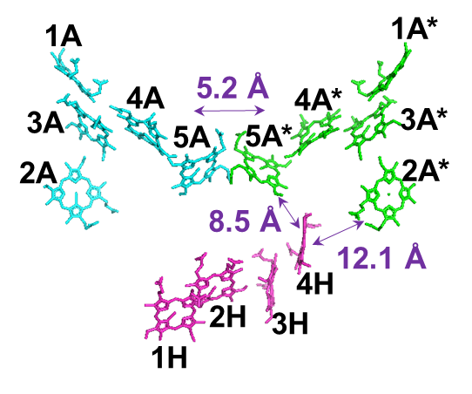
Biological Nitrogen Dioxide Reduction to Ammonium Continued
Biological NO₂⁻ Reduction to NH₄⁺
NO₂⁻ + 8H⁺ + 6e⁻ → NH₄⁺ + 2H₂O
Hegg Lab (Biochemistry)
Perform the reaction inside of biological organelle to trap and concentrate NH₄⁺

Slide 28
Next up Justin Kirkpatrick
Next up – Justin Kirkpatrick
STRATEGIC PLAN: MSU 2030

Slide 29
Justin Kirkpatrick
College of Social Science
Department of Economics
Energy + Environmental Economics

Slide 30
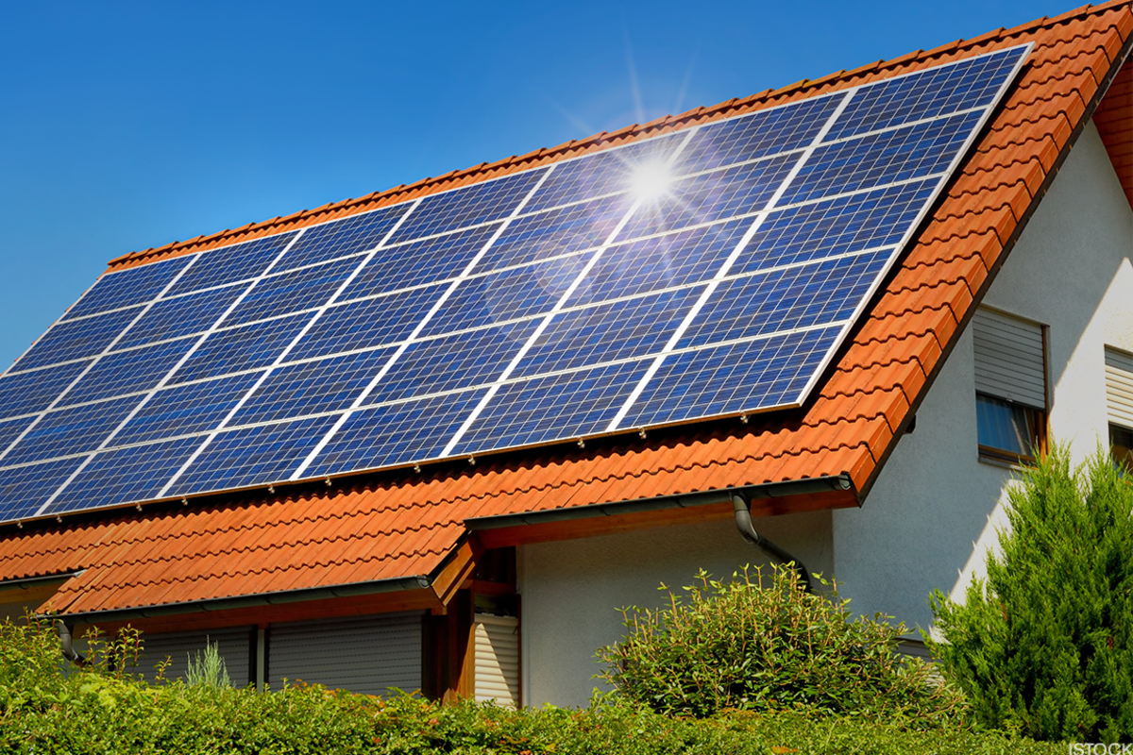
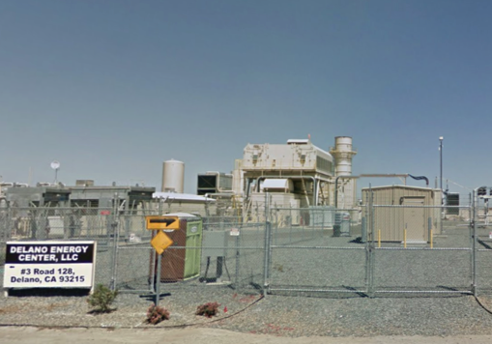
Research
How households make decisions about energy consumption and investment
Source: TheStreet.com
How these household decisions, in aggregate, affect the grid
  Price of electricity
  Pollution + carbon emissions
  Distributional concerns

Slide 31
Why are these interesting? Why economics?
Households make trade-offs between $ and electricity.
  Knowing how households do this is useful
    Predict behavior
    Value things without prices
But these are made “through a fun-house mirror”
  Rates households pay are disconnected from actual cost
    Real-time vs. constant
    Fixed cost recovery
    Pollution + carbon emissions
  Wholesale market (beyond households)
    Market power
    Long-run plant construction

Slide 32
Some prior research
Price effect of battery storage
  Wholesale electricity markets
  I estimate around 2.2% decline in wholesale power prices during evening hours
  But zero effect for “Tesla Powerwalls” owned by private households
Solar siting
  Where a panel is installed determines
    How much solar is generated
    What generator is actually offset
  “Dollarize” total value of panel

Slide 33
Call for collaboration
Anywhere a project
Needs to consider consumer behavior
Needs to value something beyond the “market price”
Market power + battery characteristics
  Power and energy both affect how a battery alters the market
Perceptions of household storage
  Operate to max. cost savings?
  Operate to min. grid consumption? (TOU pricing)
  Substitute for backup generator

Slide 34
Questions?
Time to network!
STRATEGIC PLAN: MSU 2030

